Slide 1
IT Professional Environment: Law, Ethics and Privacy
Week 8:
Lecturer: Dr. Farshid Keivanian

Slide 2
Introduction to Intellectual Property (IP)
Introductory Content:
Intellectual Property (IP) is a crucial concept in today’s technology-driven world. It refers to creations of the mind, such as inventions, literary and artistic works, designs, and symbols used in commerce. Understanding IP is essential for protecting innovation and securing financial benefits.

Slide 3
Introduction to Intellectual Property (IP)
Practical Scenario:
Consider a Sydney-based startup that develops a unique software tool for managing small business finances. This tool represents a creation of the mind and is protected under IP law. The startup needs to protect this software through copyright to prevent unauthorized use.
Class Discussion Question:
How do you think IP protection can influence a company’s success, especially in the tech industry?

Slide 4
Introduction to Intellectual Property (IP)
Response: IP protection can safeguard innovations, allowing companies to maintain a competitive edge, generate revenue through licensing, and prevent unauthorized use.

Slide 5
IP Ownership
Introductory Content:
IP ownership can be complex, especially in technology where multiple parties may contribute to a single product. Understanding the relationship between creators, businesses, and external agencies is critical in determining IP ownership.

Slide 6
IP Ownership
Practical Scenario:
Imagine an app developed by a team of freelancers for a Brisbane-based tech company. Who owns the IP: the freelancers or the company?
Class Discussion Question:
In such a scenario, how should the IP rights be managed to avoid future disputes?

Slide 7
IP Ownership
Response: IP ownership should be clearly defined in contracts, with freelancers typically transferring IP rights to the company upon completion of the project.

Slide 8
IP Risks
Introductory Content:
Misunderstanding IP can lead to significant risks, including legal disputes and financial losses. Recognizing, recording, and mitigating these risks are essential steps in managing IP effectively.

Slide 9
IP Risks
Practical Scenario:
A Melbourne-based company unknowingly uses copyrighted images in its marketing materials. What risks does this company face?
Class Discussion Question:
How can companies mitigate risks associated with IP?

Slide 10
IP Risks
Response: Companies should conduct IP audits, ensure proper licensing, and educate employees on IP laws to avoid infringement and associated penalties.

Slide 11
IP Protection
Introductory Content:
Protecting IP is not just about registering patents or copyrights; it’s about creating barriers that competitors cannot easily cross. This protection can be costly, but recognizing its value is essential.

Slide 12
IP Protection
Practical Scenario:
Consider a Canberra-based tech firm that develops a new encryption algorithm. How should the company protect its IP to ensure it remains competitive?
Class Discussion Question:
Why might a company hesitate to invest in IP protection, and what could be the consequences?

Slide 13
IP Protection
Response: High costs may deter investment, but the lack of protection can lead to loss of competitive advantage and potential legal battles.

Slide 14
IP for Technology
Introductory Content:
In the tech industry, IP has increasingly gained value over physical assets. IP rights apply to data, intangible assets, and innovative systems, making it crucial for tech companies to safeguard their creations.

Slide 15
IP for Technology
Practical Scenario:
A software development company in Sydney creates a new data management system. How should they protect this system from software piracy?
Class Discussion Question:
What steps can tech companies take to protect their IP from piracy?

Slide 16
IP for Technology
Response: Regular IP audits, clear IP strategies, robust cybersecurity measures, and strict confidentiality agreements can help protect IP from piracy and unauthorized access.

Slide 17
Managing IP in Technology
Introductory Content:
Managing IP in the tech industry involves more than just filing for IP rights. It includes creating a comprehensive IP strategy, conducting regular audits, and safeguarding innovation through cybersecurity.

Slide 18
Managing IP in Technology
Practical Scenario:
A Brisbane-based company experiences a cyberattack that compromises its proprietary software code. What steps should the company have taken to protect its IP?
Class Discussion Question:
How can regular IP audits and strong cybersecurity measures prevent IP theft in technology?

Slide 19
Managing IP in Technology
Response: Regular audits help identify potential vulnerabilities, while strong cybersecurity measures protect against unauthorized access and theft of intellectual property.

Slide 20
Group Class Activity – Presentation Calibri Size 28 (f.keivanian@aapoly.edu.au)
Group Activity:
Task:
In group, create a detailed IP strategy for a hypothetical tech startup based in Melbourne. Each group member will focus on one aspect of the strategy (e.g., patent filing, IP audits, cybersecurity measures). Afterward, present your strategy to the class and discuss the potential challenges and solutions.

Slide 21
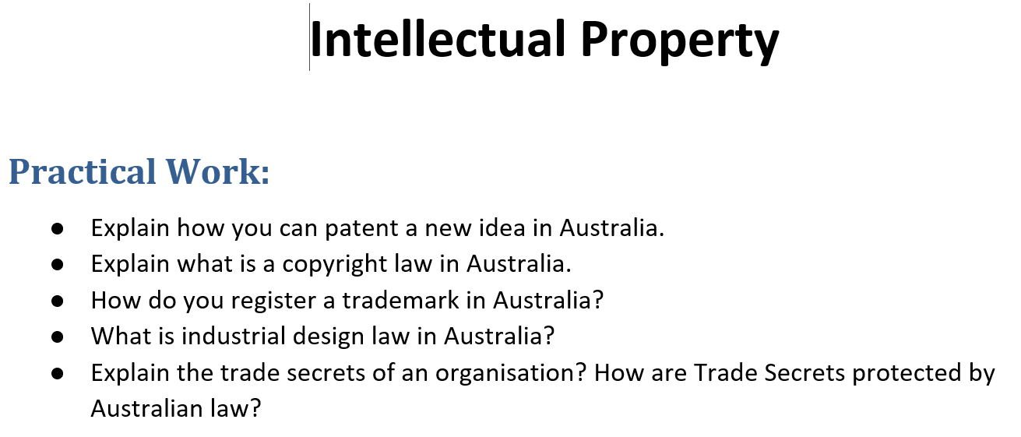
Tutorial Week 8

Slide 22
Tutorial Week 8
Practical Work: Intellectual Property in Australia
1. How You Can Patent a New Idea in Australia
Explanation: To patent a new idea in Australia, you need to follow these steps:
Step 1: Ensure Your Idea is Patentable: Not all ideas can be patented. Your idea must be new, involve an inventive step, and be useful. It should not have been publicly disclosed before applying for the patent.

Slide 23
Tutorial Week 8
Step 2: Conduct a Patent Search: Check existing patents to ensure your idea has not already been patented. This can be done through IP Australia’s online database or by hiring a patent attorney.
Step 3: Prepare a Patent Application: You need to file either a provisional application (which gives you 12 months to file a complete application) or a complete application directly. A patent attorney can help draft the application to ensure it covers all aspects of your invention.

Slide 24
Tutorial Week 8
Step 4: File the Application with IP Australia: Submit your application online via IP Australia’s eServices portal, paying the required fees.
Step 5: Examination: IP Australia will examine your application to ensure it meets all the requirements. This process may take several years, during which you may need to respond to any objections raised by the examiner.
Step 6: Patent Grant: If your application is successful, your patent will be granted, giving you exclusive rights to your invention for up to 20 years.

Slide 25
Tutorial Week 8
2. What is Copyright Law in Australia?
Explanation: Copyright law in Australia protects the expression of ideas rather than the ideas themselves. It covers a wide range of works, including literary, artistic, musical, and dramatic works, as well as films, broadcasts, and software. Key points about copyright law in Australia include:

Slide 26
Tutorial Week 8
Automatic Protection: Copyright protection is automatic as soon as the work is created and does not require registration.
Duration: Copyright generally lasts for 70 years after the death of the creator.
Exclusive Rights: The copyright owner has the exclusive right to reproduce, publish, perform, communicate, and adapt the work.
Infringement: Unauthorized use of copyrighted material is considered infringement, which can result in legal action.

Slide 27
Tutorial Week 8
3. How to Register a Trademark in Australia
Explanation: To register a trademark in Australia, follow these steps:
Step 1: Search Existing Trademarks: Use IP Australia’s ATMOSS database to search for existing trademarks to ensure your proposed trademark is unique.
Step 2: Decide on the Trademark: Your trademark can be a word, phrase, logo, or a combination. Ensure it is distinctive and not descriptive of the goods or services.

Slide 28
Tutorial Week 8
Step 3: File the Application: Submit a trademark application online through IP Australia’s eServices portal, specifying the classes of goods or services your trademark will cover.
Step 4: Examination: IP Australia will examine your application to ensure it complies with the law and does not conflict with existing trademarks.
Step 5: Publication and Opposition: If your application passes the examination, it will be published in the Australian Official Journal of Trade Marks. Third parties have two months to oppose the registration.

Slide 29
Tutorial Week 8
Step 6: Registration: If no opposition is filed, or if any opposition is resolved, your trademark will be registered, giving you exclusive rights for 10 years, with the option to renew.

Slide 30
Tutorial Week 8
4. What is Industrial Design Law in Australia?
Explanation: Industrial design law in Australia protects the visual design of objects that are not purely utilitarian. This can include the shape, configuration, pattern, or ornamentation of a product. Key aspects of industrial design law include:

Slide 31
Tutorial Week 8
Registration Requirement: Unlike copyright, industrial design protection requires registration.
Novelty Requirement: The design must be new and distinctive, meaning it should not have been disclosed to the public before filing.
Duration: Registered designs are protected for an initial period of five years, with the possibility of renewal for a further five years, providing up to 10 years of protection.
Rights: The registered owner has the exclusive right to use, license, or sell the design.

Slide 32
Tutorial Week 8
5. What are Trade Secrets, and How are They Protected by Australian Law?
Explanation: Trade secrets are confidential business information that provides a company with a competitive edge. This can include formulas, practices, processes, designs, instruments, or a compilation of information. Trade secrets are not registered but are protected through legal means, such as:

Slide 33
Tutorial Week 8
Non-Disclosure Agreements (NDAs): Companies often require employees, partners, and vendors to sign NDAs to legally bind them to confidentiality.
Employment Contracts: Clauses in employment contracts can prevent employees from disclosing or using trade secrets after they leave the company.
Common Law: Under common law, companies can sue for breach of confidence if a trade secret is disclosed without permission.
Injunctions: Courts can issue injunctions to prevent the misuse or disclosure of trade secrets.

Slide 34
Tutorial Week 8
Trade secrets remain protected as long as they remain confidential, unlike patents, which have a fixed term of protection.

